Slide 1

Logistics Cost & Delivery Analytics (ADLS + ADF + Databricks + Power BI)
Group 1
Drupad Dev P
Mayur A
Sourav Shetty
Ekta Patil
Sayana Dey

Slide 2




Project Overview
An automated, end-to-end analytics platform for logistics operations
Daily ingestion of shipment data
Data quality & governance built-in
Analytics-ready outputs for business users
End Goal: The goal was not just to move data, but to build a governed platform that supports operational and executive decision-making.

Slide 3
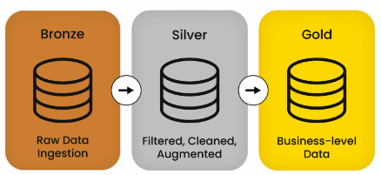
End-to-End Logistics Analytics Platform on Azure
Linked Services
    • ADLS
    • ADF
    • Databricks
    • Power BI
Medalion Architecture

Slide 4
Project Challenge and Business Problem Abstraction
Logistics data existed, but insights did not.
“From raw logistics files → governed analytics → business decisions”
Disparate daily shipment files
No trust in cost & delivery metrics
No single analytics-ready dataset
Abstracted the problem into 3 layers:
  Data arrival is unreliable
  Data quality issues are common
  Business users need clean KPIs
Solution required automation, validation, and modeling

Slide 5
Inputs & Resources
CSV shipment & reference files
Add photo of Given File and its analytics
Raw CSV shipment extracts
Reference data (warehouses, carriers, regions)
Business KPI expectations
The data was intentionally imperfect
It contained nulls, duplicates, and anomalies to simulate real enterprise conditions
This allowed us to test data quality and governance, not just ingestion

Slide 6
Data Simulation Design (Data Generation)
3,000 → 2.5M shipment records
    Data was synthetically generated but, Preserved real-world distributions
  Introduced controlled data quality issues
30 days of data
Introduced controlled data quality issues

Slide 7
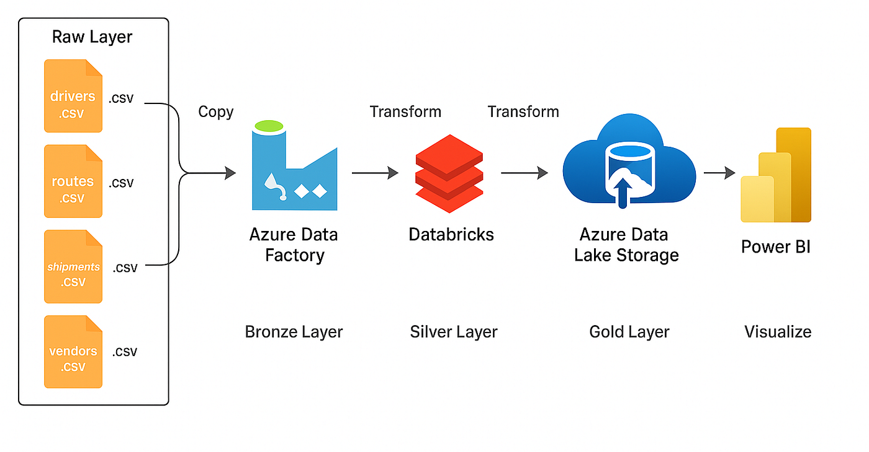
Azure Services Stack
Azure Data Lake Storage
Azure Data Factory
Azure Databricks
Power BI

Slide 8
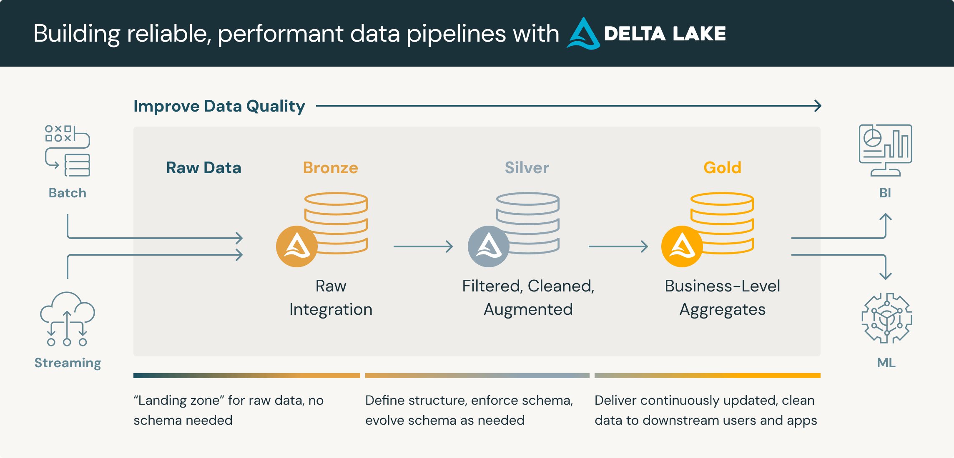
Architecture Overview
Medalion Architecture
  Bronze → Silver → Gold
We followed the Medallion Architecture
Each layer improves data quality and usability
This makes the platform auditable, testable, and BI-optimized

Slide 9
Data Lake Organization
Add images

Slide 10
Raw Data Handling
Date partitioned raw data
No Transformations
Add image

Slide 11
Data Orchestration with ADF
Pipeline
Trigger
Validation Steps

Slide 12
Watermark & Control Mechanism
Last successful ingest date
Stored in control container
Prevents reprocessing
Enables safe reruns
Industry-standard incremental pattern

Slide 13
Databricks: Silver Transformations Data Cleaning & Quality
Typed schema
Deduplication
DQ flags
Applied PySpark transformations:
  Null handling
  Duplicate resolution
  Outlier detection
Bad records routed to quarantine, not deleted

Slide 14
Databricks: Silver Transformations

Slide 15
Analytics-Ready Gold Layer
  Designed specifically for Power BI performance
  Star Schema Maintained (Fact + Dimensions)
  Incremental Merge Logic (Ensuring No Schema Break)

Slide 16
Security And Authentication
Managed identities
Secure access patterns
No hardcoded secrets
Services authenticate using Azure-native identity
Enterprise-grade security posture

Slide 17
Automation
Scheduled triggers
Notebook execution
Real Time Power Bi Update
Once deployed, the system runs end-to-end automatically
Ingestion, transformation, and publishing require no manual steps
Failures are isolated and recoverable

Slide 18
Power BI Insights
Executive overview
Carrier performance
Data quality

Slide 19
Group 1

